Slide 1
Snow-pocalypse 2021
Analysis of Energy Demand, Price, and Temperature correlation in Texas during the 2021 Winter storm

Slide 2
Executive Summary
Determine the economic impact of the 2021 Texas Winter Storm by analyzing energy supply prices in correlation with demand and temperature data.

Slide 3
Data Sources
ERCOT
Settlement Prices in 15-minute intervals
Degree Days
Estimation of energy consumption on a given day
Weather Underground
Hourly weather data

Slide 4
Data Collection
ERCOT
Excel spreadsheet
Real-Time Market Price
Degree Days
CSV files
Free search tool gives historical data going back up to 36 months
Weather Underground
Hourly weather data
Screen scraping using splinter and beautiful soup

Slide 5
Data Cleanup
ERCOT:
Slice data to specific settlement points
Remove commas from price
Degree Days
Not much clean-up required
Slice to a relevant dataset based on month
Weather Underground
Remove non-unicode characters (degree symbol removed)
Remove the letter 'F' in defining Fahrenheit as the temperature scale.

Slide 6
Data Exploration
Visualizations with HvPlot

Slide 7
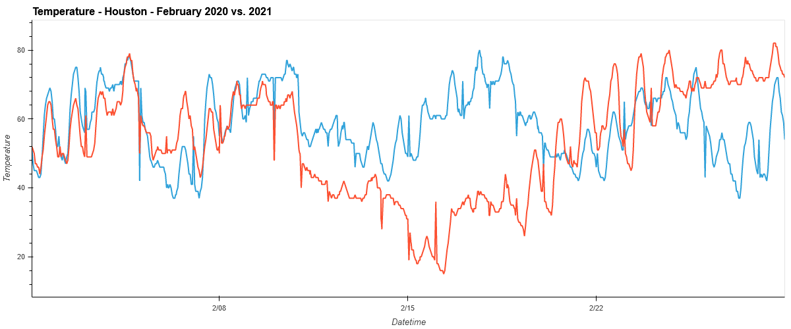
Temperature

Slide 8
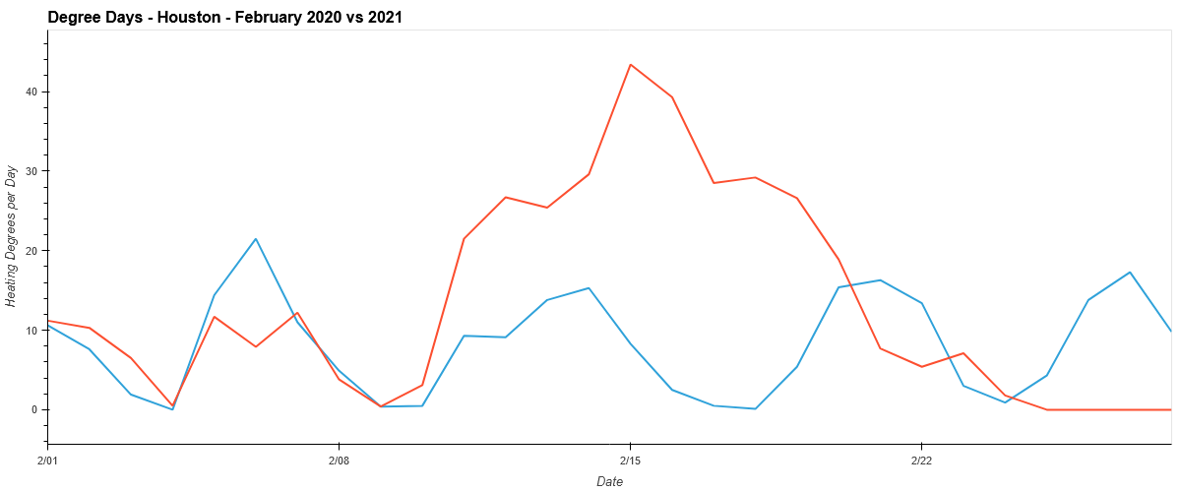
Energy Demand

Slide 9
Temperature & Energy Demand

Slide 10
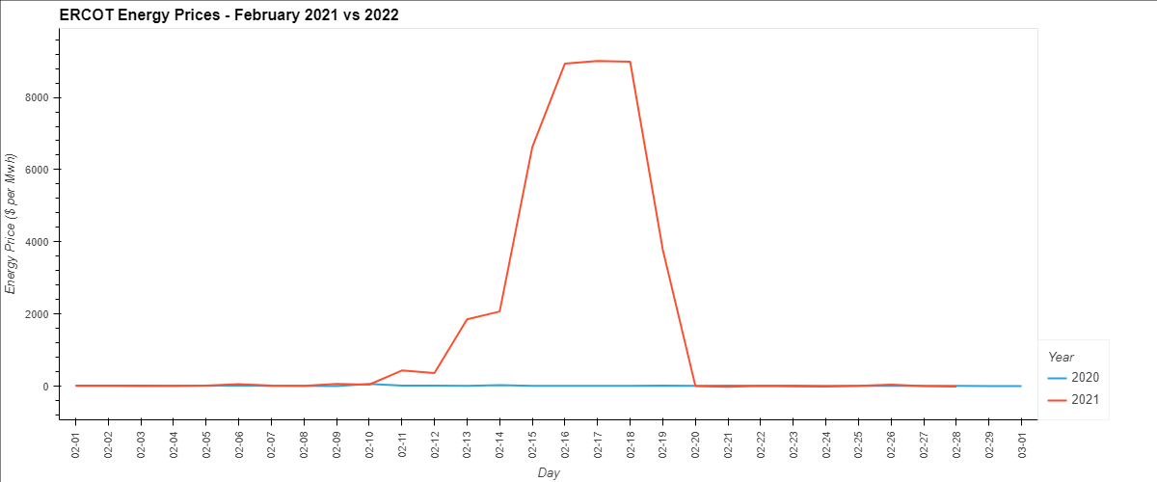
Energy Prices

Slide 11
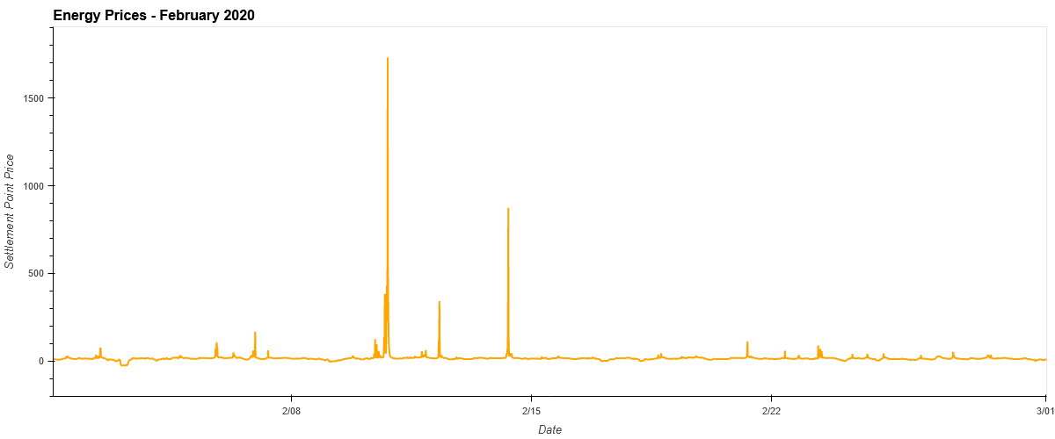
ERCOT Real-Time-Market Price 2020

Slide 12
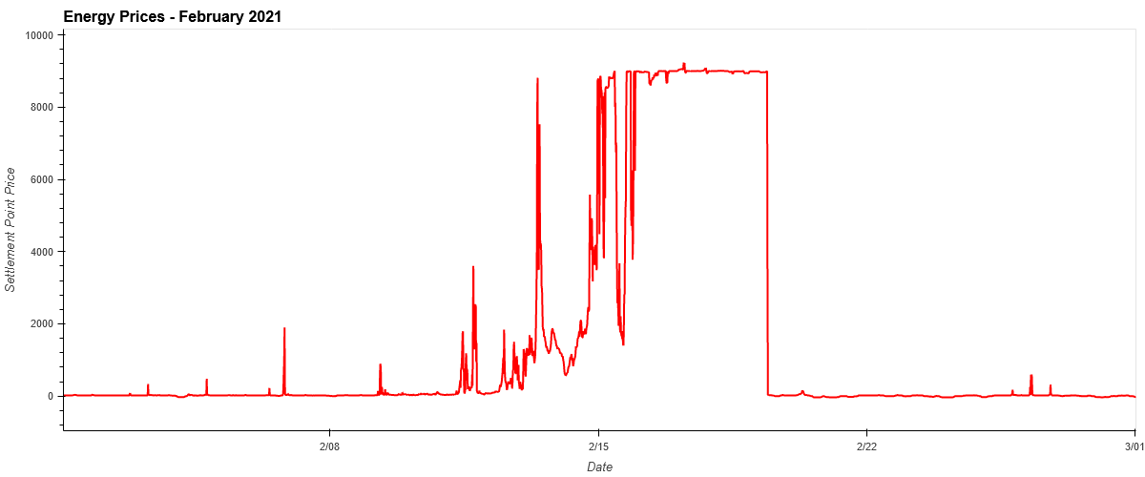
ERCOT Real-Time-Market Price 2021

Slide 13
ERCOT Real-Time-Market Prices
2020
2021

Slide 14
Our Approach
Created individual Python files to stage and cleanse the data one time and push it into a database
After initial plots of the data, we started to look for news articles that may have contributed to what the data was reflecting.
Plotting data that linear in when we wanted to present the data as an over-lay visualization.

Slide 15
Challenges
Screen scraping weather data from http
Formatting the data to create an overlay plot from time series data

Slide 16
Results / Conclusion
Demand was up, supply was down, prices were up from 2/10 – 2/19
Expected correlations were true – drastic temperature change caused increase in energy demand and settlement point price.
ERCOT kept prices at the cap for 2 days longer than needed.

Slide 17
Next Steps
Build predictive models to project energy prices
What would the correlation look like if we had actuals for energy consumption?
Why did ERCOT hold prices at the max limits longer than needed? (Supply increased and ambient temperature increased.)

Slide 18
Questions?

